Slide 1
Working with Classes
-By Nimesh Kumar Dagur

Slide 2
Class
When you define a class, you define a blueprint for a data type.
Class is a template, declaration or blueprint that is used for classifying object.
It encapsulates variable members, functions, structure, properties and many more components.
It is the basic building block of object oriented programming.
The methods and variables that constitute a class are called members of the class.

Slide 3
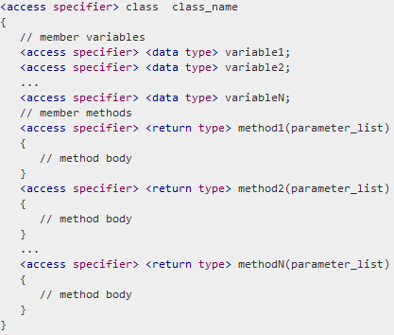
Defining a Class
A class definition starts with the keyword class followed by the class name; and the class body enclosed by a pair of curly braces.

Slide 4
Guideline while creating class
Access specifiers specify the access rules for the members as well as the class itself.
If not mentioned, then the default access specifier for a class type is internal.
Default access for the members is private.
Data type specifies the type of variable, and return type specifies the data type of the data the method returns, if any.
To access the class members, you use the dot (.) operator.
The dot operator links the name of an object with the name of a member.

Slide 5
The class name should be noun and meaningful.
Use either pascal case or camel case.
In camel case, the first letter is small. Ex. camelCase.
In pascal case first letter is capital. Ex. PascalCase.
It is strictly recommended you to use pascal case for class name and camel case for variable name.
Your class name should not contain any special character except underscore (_) or digit. Must start your class name with character.
Don’t use reserved keyword for class name.

Slide 6
After creating class, you can use it by creating its object.
An object is created using new keyword.

Slide 7
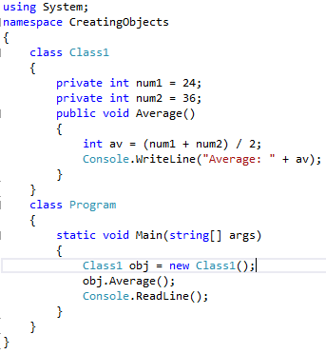
Creating Objects

Slide 8
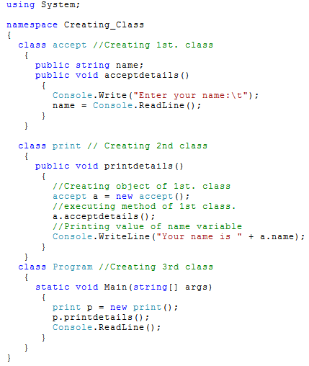


Slide 9
Member Functions
A member function of a class is a function that has its definition or its prototype within the class definition similar to any other variable.
It operates on any object of the class of which it is a member, and has access to all the members of a class for that object.
Member variables are the attributes of an object and they are kept private to implement encapsulation.
These variables can only be accessed using the public member functions.

Slide 10
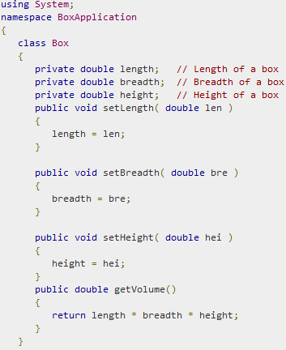

Slide 11
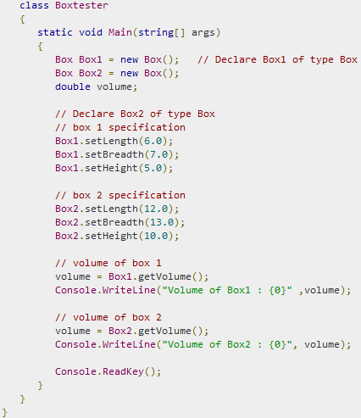


Slide 12
C# Constructors
A class constructor is a special member function of a class that is executed whenever we create new objects of that class.
A constructor has exactly the same name as that of class and it does not have any return type.
• A constructor is used to initialize the state of the class instance.
• If you want to be able to create instances of your class from outside the class, you need to declare the constructor public.
A constructor cannot have a return value.

Slide 13
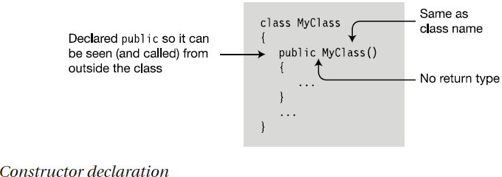

Slide 14
C# Destructors
A destructor is a special member function of a class that is executed whenever an object of its class goes out of scope.
A destructor has exactly the same name as that of the class with a prefixed tilde (~) and it can neither return a value nor can it take any parameters.
Destructor can be very useful for releasing memory resources before exiting the program.
Destructors cannot be inherited or overloaded.

Slide 15
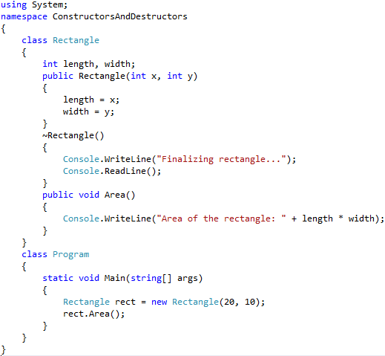


Slide 16
Instance Class Members
Class members can be associated with an instance of the class or with the class as a whole; that is, to all the instances of the class.
By default, members are associated with an instance.
You can think of each instance of a class as having its own copy of each class member. These members are called instance members.
Changes to the value of one instance field do not affect the values of the members in any other instance.

Slide 17
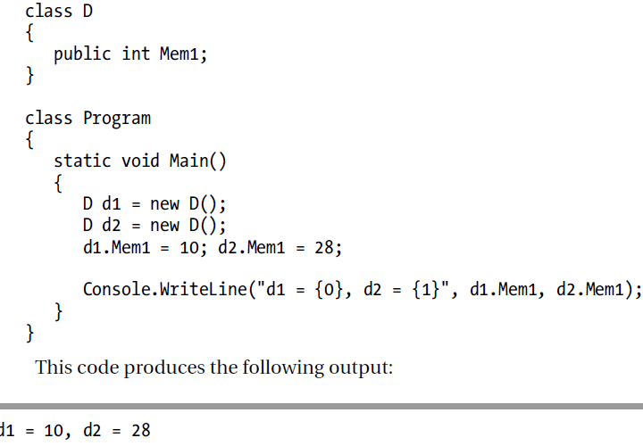

Slide 18
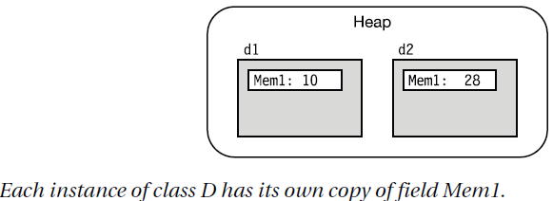

Slide 19
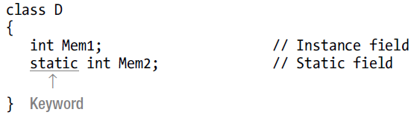
Static Fields
• A static field is shared by all the instances of the class, and all the instances access the same memory location.
• Use the static modifier to declare a field static,

Slide 20
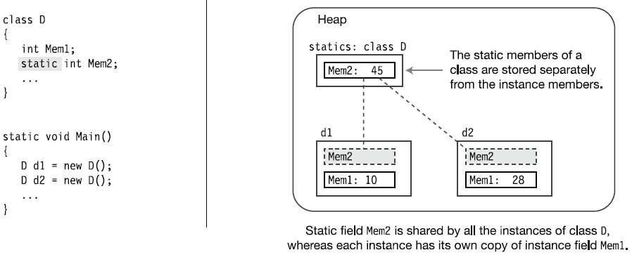

Slide 21
Static Members of a C# Class
We can define class members as static using the static keyword.
When we declare a member of a class as static, it means no matter how many objects of the class are created, there is only one copy of the static member.
The keyword static implies that only one instance of the member exists for a class.
Static variables are used for defining constants because their values can be retrieved by invoking the class without creating an instance of it.
Static variables can be initialized outside the member function or class definition.
You can also initialize static variables inside the class definition.
You can also declare a member function as static. Such functions can access only static variables. The static functions exist even before the object is created.

Slide 22
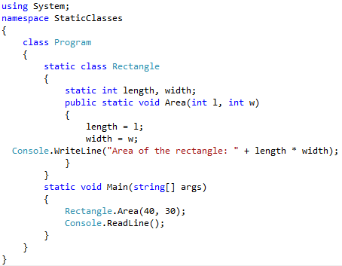

Slide 23
Accessibility
Class accessibility describes the visibility of a class;
Member accessibility describes the visibility of the members of a class object.
With class accessibility, there are only two modifiers—internal and public.
Each member declared in a class is visible to various parts of the system, depending on the access modifier assigned to it in its class declaration.
Private members are visible only to other members of the same class, while public members can be visible to classes outside the assembly as well.

Slide 24
Access Modifiers
From within a class, any function member can access any other member of the class by simply using that member’s name.
The access modifier is an optional part of a member declaration that specifies what other parts of the program have access to the member.
The access modifier is placed before the simple declaration forms.

Slide 25
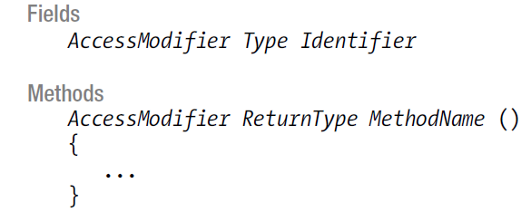
Syntax

Slide 26
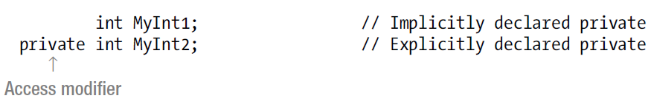
Private and Public Access
Private members are accessible only from within the class in which they are declared—other classes cannot see or access them.
Private access is the default access level, so if a member is declared without an access modifier, it is a private member.
You can also use the private access modifier to explicitly declare a member as private.
There’s no semantic difference between declaring a private member implicitly as opposed to explicitly.

Slide 27
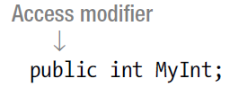
Private and Public Access
Public members of an instance are accessible to other objects in the program.
You must use the public access modifier to specify public access.

Slide 28
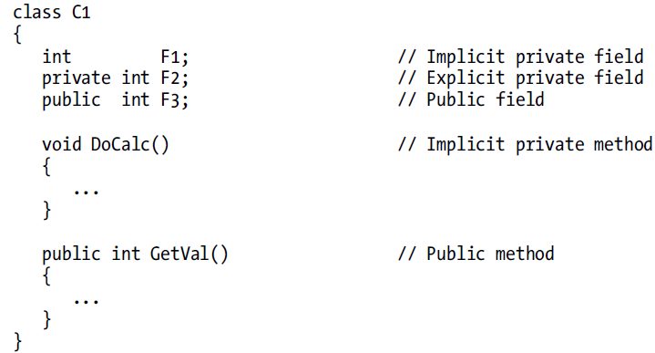
Example of Member Access

Slide 29
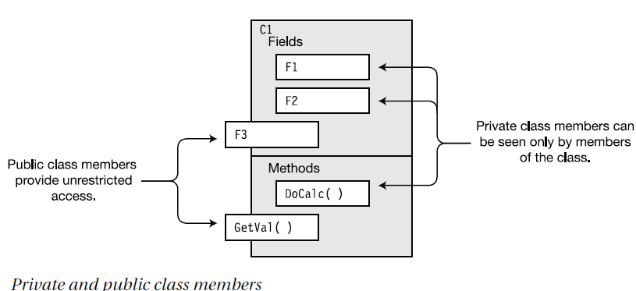

Slide 30
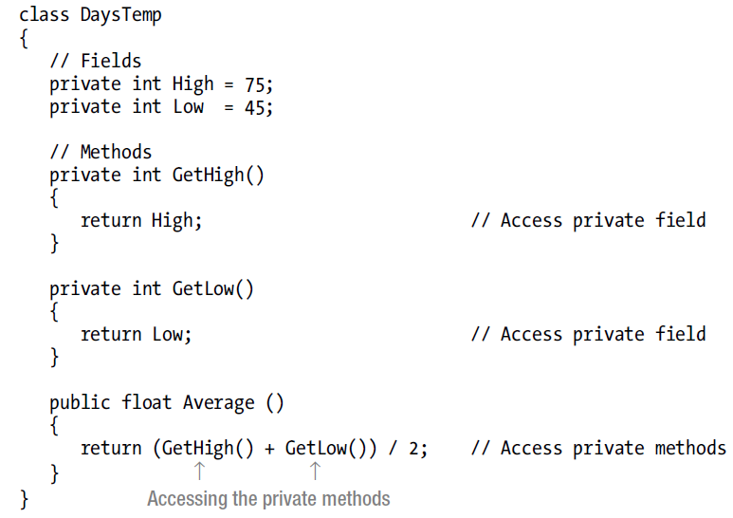
Accessing Members from Inside the Class
Class declaration shows the methods of the class accessing the fields and other methods. Even though the fields and two of the methods are declared private, all the members of a class can be accessed by any method (or any function member) of the class.

Slide 31
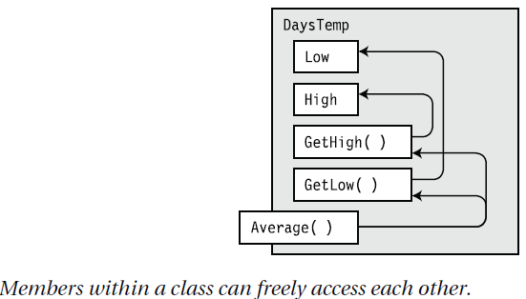

Slide 32
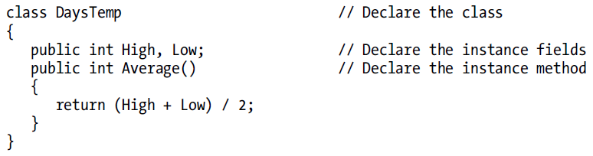
Accessing Members from Outside the Class

Slide 33
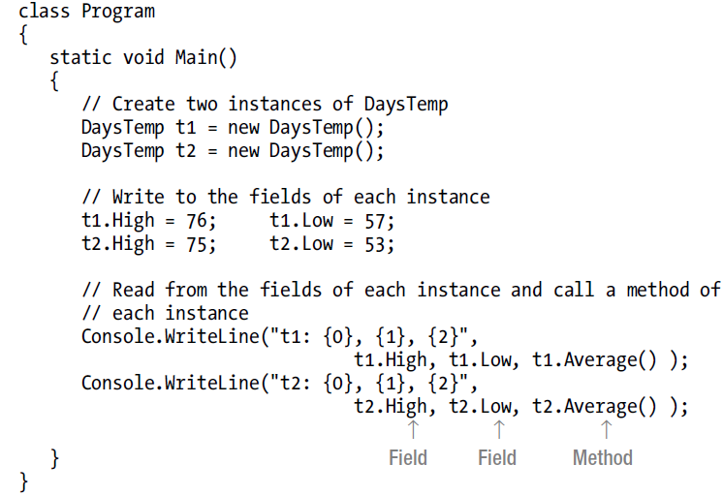


Slide 34
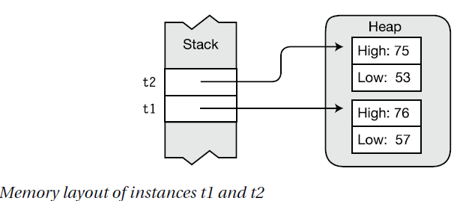

Slide 35
Regions Accessing a Member - C# Access Specifiers(Modifier)
A class specifies which of its members can be accessed by other classes by labelling its members with access modifiers.
In C# there are five types of access specifiers are available.
1.Public Access Specifiers
2.Private Access Specifiers
3.Protected Access Specifiers
4.Internal Access Specifiers
5.Protected Internal Access Specifiers.

Slide 36
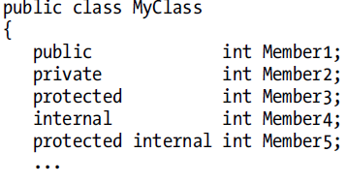
Access Modifier

Slide 37
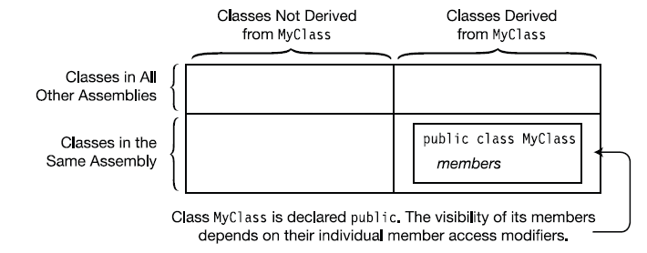

Slide 38
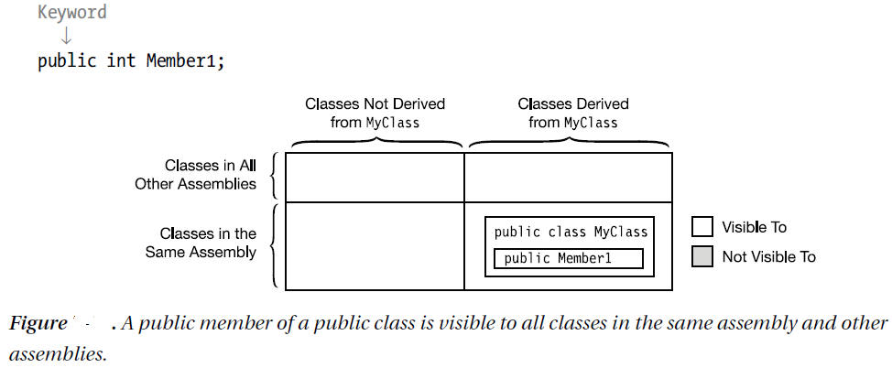
Public Member Accessibility

Slide 39
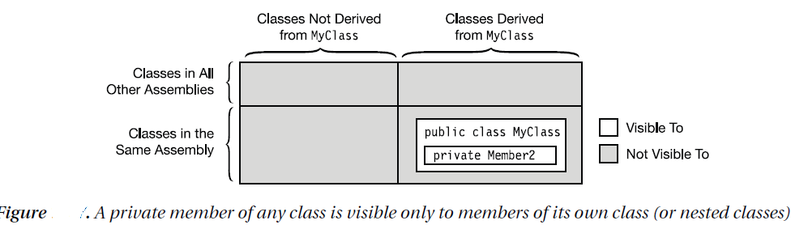
Private Member Accessibility

Slide 40
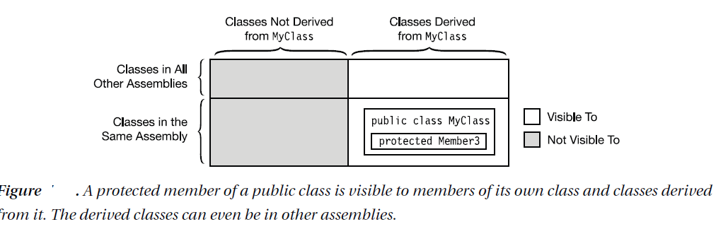
Protected Member Accessibility

Slide 41
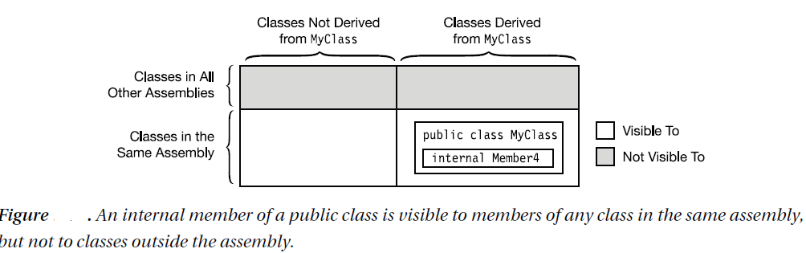
Internal Member Accessibility

Slide 42
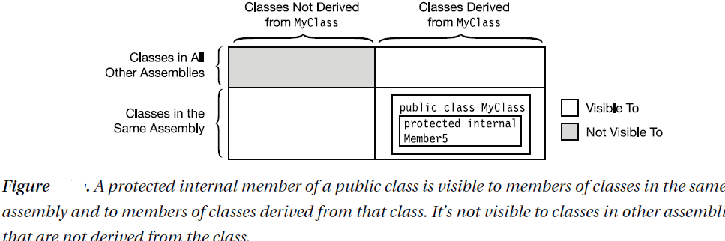
Protected Internal Member Accessibility

Slide 43
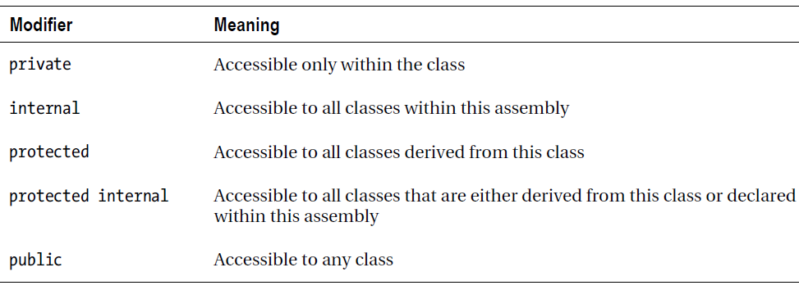
Summary

Slide 44
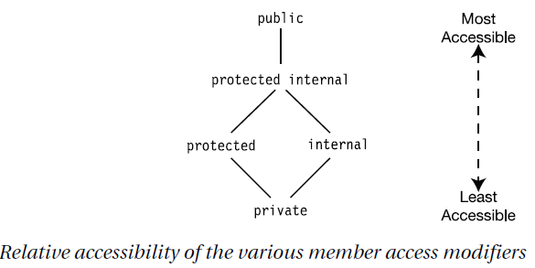
Relative accessibility of the five member access modifiers

Slide 45
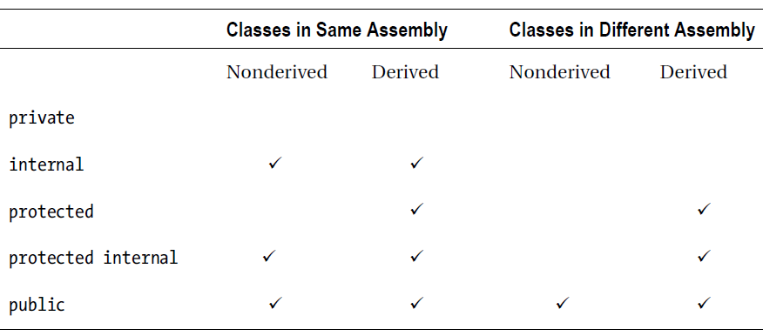
Summary of Member Accessibility

Slide 46
Partial Classes
The declaration of a class can be partitioned among several partial class declarations.
Each of the partial class declarations contains the declarations of some of the class members.
The partial class declarations of a class can be in the same file or in different files.
Each partial declaration must be labelled as partial class, in contrast to the single keyword class.
The declaration of a partial class looks the same as the declaration of a normal class, other than the addition of the type modifier partial.
All the partial class declarations comprising a class must be compiled together.
A class using partial class declarations has the same meaning as if all the class members were declared within a single class declaration body.

Slide 47
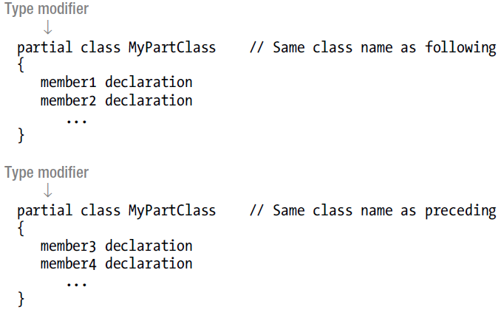

Slide 48
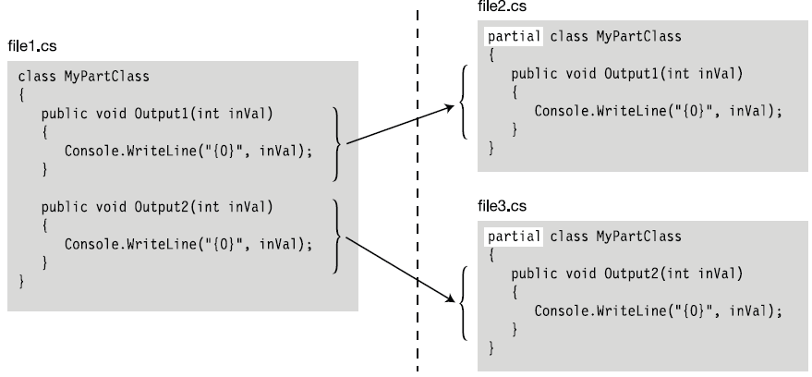

Slide 49
Inheritance
Inheritance allows you to define a new class that incorporates and extends an already declared class.
You can use an existing class, called the base class, as the basis for a new class, called the derived class.
The members of the derived class consist of the following:
− The members in its own declaration
− The members of the base class

Slide 50
To declare a derived class, you add a class-base specification after the class name.
The class-base specification consists of a colon, followed by the name of the class to be used as the base class.
The derived class is said to directly inherit from the base class listed.
• A derived class is said to extend its base class, because it includes the members of the base class plus any additional functionality provided in its own declaration.
• A derived class cannot delete any of the members it has inherited.

Slide 51
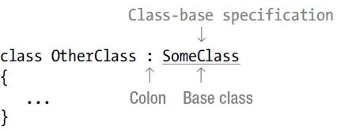
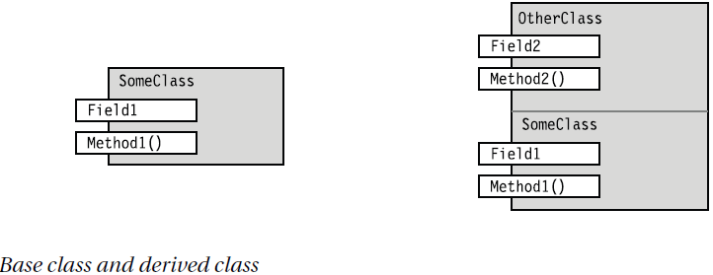

Slide 52
Sealed Classes
A sealed class is a class that can not be inherited.
The sealed keyword is used to indicate that class is sealed and it can not be inherited.

